Slide 1
Digital Book Store
(Smart Contract use case)
Group: Titans

Slide 2
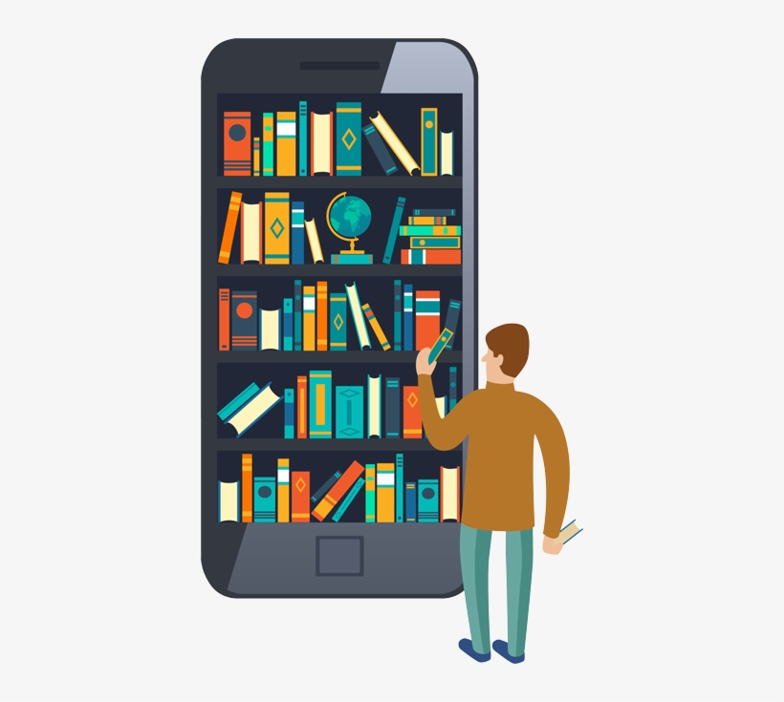
Digital Book Store
Our goal is to create a Digital Book Store, which allows Authors to sell their books directly to whomever want to buy a digital copy. This exchange will be saved in a decentralized distributed ledger.
All the money will go to the Author
Content will be available in all formats; eBooks and Audible books.

Slide 3
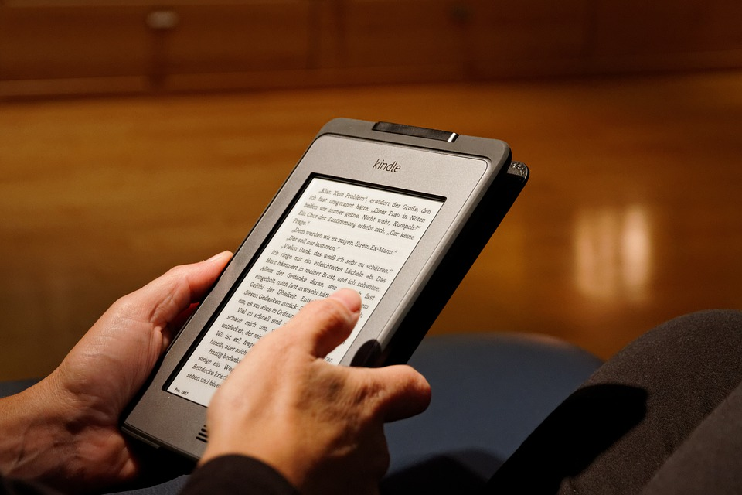
Decentralized Vs Centralized
The Centralized solution in this case rely on one individual to make decisions, provide direction, decide the prices, fees which will not be published.
The Decentralized solution will provide variety and autonomy.

Slide 4
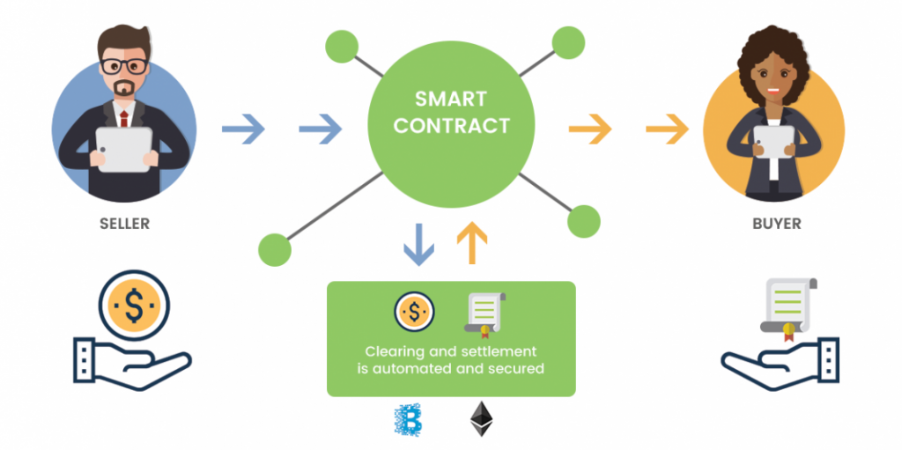
Smart Contracts

